Slide 1
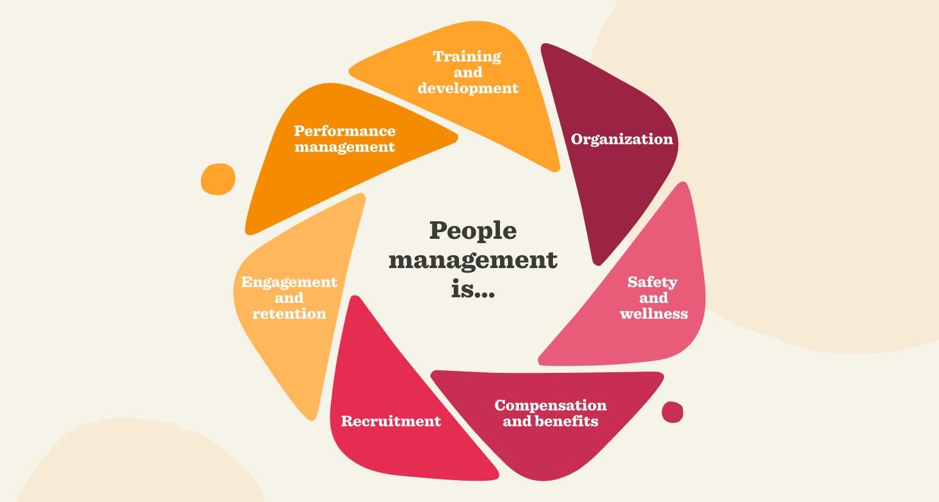
PEOPLE MANAGEMRNT
"The greatest asset of a company is its people."
— Jorge Paulo Lemann
Senior Prof. MVR RAJU Principal College of Science & Technology Andhra University, Visakhapatnam

Slide 2
“People management is not just about supervising others—it’s about motivating, leading, and bringing out the best in individuals and teams.”

Slide 4
People Management
Leading: Guiding employees to meet company goals.
Developing: Improving employee skills and growth.
Motivating: Inspiring employees to perform well.
Coordinating: Ensuring teamwork and smooth workflows.
Key Activities:
  Hiring
  Onboarding
  Training
  Performance Evaluation
  Employee Retention

Slide 5
"Understanding People Management Through Psychological Theories"
Maslow’s Hierarchy of Needs
People are motivated by five levels of needs:
Physiological → Safety → Love/Belonging → Esteem → Self-Actualization
Application in management:
  Provide job security (Safety)
  Foster team bonding (Belonging)
  Recognize achievements (Esteem)
  Help employees grow and learn (Self-Actualization)

Slide 6
Herzberg’s Two-Factor Theory
Motivators (Intrinsic factors) – Create job satisfaction
Hygiene Factors (Extrinsic factors) – Prevent job dissatisfaction
Motivators – Factors that increase satisfaction:
Achievement
Recognition
Meaningful work
Responsibility
Personal growth opportunities
Hygiene Factors – Factors that prevent dissatisfaction:
Salary
Job security
Company policies
Working conditions
Supervision

Slide 7
Qualities of an Effective People Manager
Communication
Empathy
Conflict resolution
Delegation
Motivation

Slide 8
Barriers to Effective People Management
Team conflicts
Performance issues
Diversity and inclusion
Resistance to change

Slide 9
The Power of Words in Management
Active listening
Feedback types (positive, constructive)
Non-verbal cues

Slide 10
The Art of Employee Motivation
Recognize and Reward Achievements
  Celebrate both small and big wins regularly.
Give Constructive Feedback
  Offer honest and supportive feedback to help growth.
Set Clear Goals and Expectations
  Clear direction boosts focus and motivation.
Understand Individual Motivators
  Everyone is driven by different factors (e.g., recognition, growth).
Involve Team in Decision-Making
  Empowers them and builds ownership.
Provide Opportunities for Growth
  Include training, learning, and promotions.
Foster a Positive Work Environment
  Build trust, respect, and open communication.

Slide 11
Smart Strategies for Conflict Management
Stay Neutral
Be fair — don’t take sides.
Listen to Both Sides
Let everyone talk without interrupting.
Find the Real Problem
Look deeper to understand the true cause.
Focus on Solutions
Avoid blaming — think about fixing the issue.
Make a Plan Together
Work on a solution that helps both parties.
Follow Up
Check if things are better later.

Slide 12
Easy Time & Team Management
Do First Things First
Start with tasks that matter the most.
Make a To-Do List
Break big work into small, clear steps.
Share the Load
Don’t try to do everything — give tasks to others.
Let Them Work Their Way
Give freedom to your team to handle tasks.
Trust, Don’t Control
Look at the final result, not every small action.
Check In, Not Oversee
Use weekly updates or tools to stay informed.
Help Others Improve
Train your team so they become more independent.

Slide 13
“People don’t leave bad jobs—they leave bad managers.”
“Good managers support; great managers inspire.”

Slide 14


